Slide 1
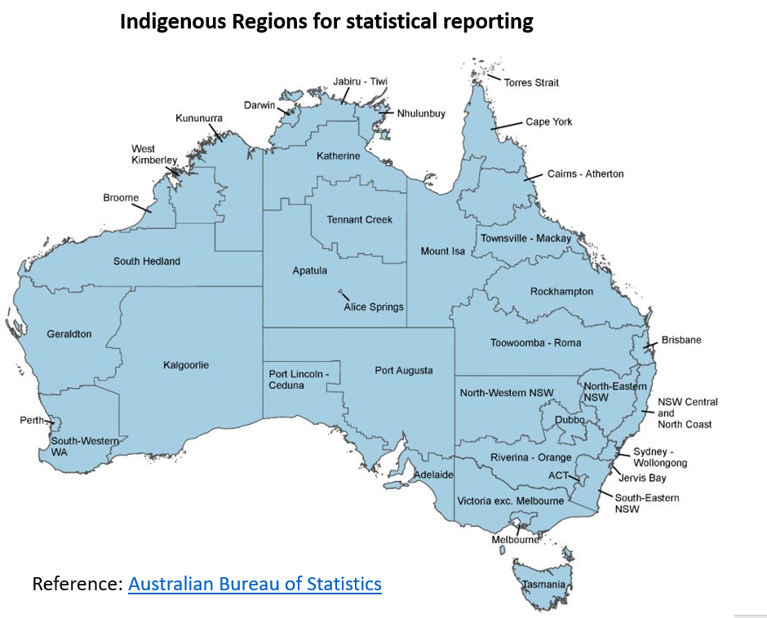
Notes:
INTERPRETATION
The Australian Bureau of Statistics uses 38 Indigenous Regions (IREGs) across Australia for Aboriginal and Torres Strait Islander statistical reporting. These regions are based on locations of specific Indigenous populations.
The ERASE study maps include results for 33 of these 38 regions, after excluding three jurisdictions (namely, Tasmania, Victoria and the Australian Capital Territory); jurisdictions for which RHD registers exist and covering 83% of the Aboriginal and Torres Strait Islander population in Australia.
These have been grouped into nine broad regions to identify any North to South gradients within the Australian States and the Northern Territory, as shown by the bold outlines on this map.
These are the IREG9 areas used by the ERASE study:
Western Australia North – Broome, Kununurra, South Hedland, West Kimberley
Western Australia Other – Geraldton, Kalgoorlie, South-Western Western Australia
NT Top End – Darwin, Jabiru-Tiwi, Katherine, Nhulunbuy
NT Central – Alice Spring, Apatula, Tennant Creek
SA Other – Port Augusta, Port Lincoln-Ceduna
Qld North – Cairns-Atherton, Cape York, Mount Isa, Torres Strait, Townsville-Mackay
Qld Other – Rockhampton, Toowoomba-Roma
NSW Other – Dubbo, North-Eastern NSW, North-Western NSW, NSW Central and North Coast, Riverina-Orange, South-Eastern NSW
Metro – Sydney-Wollongong, Brisbane, Adelaide, Perth

Slide 2
Age-standardised ARF or RHD prevalence
per 100,000 total population (0-54y), 2015-2017
Katzenellenbogen JM, Bond-Smith D, Cunneen R, et al. Contemporary Incidence and Prevalence of Rheumatic Fever and Rheumatic Heart Disease in Australia Using Linked Data: The Case for Policy Change. Journal of the American Health Association. 2020; 9(19): e016851.
Katzenellenbogen JM, Bond-Smith D, Cunneen R, et al. The End Rheumatic Heart Disease in Australia Study of Epidemiology (ERASE) Project: data sources, case ascertainment and cohort profile. Clinical Epidemiology. 2019; 11:997-1010.
Notes:
INTERPRETATION
Age-standardised rates of a disease are summary population rates across age groups that account for differences in the age-structures of the populations being compared. Rates presented here are age-standardised.
Prevalence means the proportion of people living with a health condition during a specific period and is presented per 100,000 people.
The prevalence of ARF or RHD has been adjusted for differences in the age-structures of the different regions. The colour gradient represents increasing prevalence with increasing darkness.
The age-standardised prevalence for ARF or RHD (combined) in the TOTAL Australian population (Indigenous and non-Indigenous) aged under 55 years between 2015 and 2017 was highest in the Northern Territory and lowest in the New South Wales non-metro area (1195 vs. 17 per 100,000).
The average ARF or RHD (combined) prevalence in the TOTAL Australian population is 55 per 100,00.

Slide 3
Age-standardised ARF or RHD prevalence
per 100,000 Indigenous population (0-54y), 2015-2017
Katzenellenbogen JM, Bond-Smith D, Cunneen R, et al. Contemporary Incidence and Prevalence of Rheumatic Fever and Rheumatic Heart Disease in Australia Using Linked Data: The Case for Policy Change. Journal of the American Health Association. 2020; 9(19): e016851.
Katzenellenbogen JM, Bond-Smith D, Cunneen R, et al. The End Rheumatic Heart Disease in Australia Study of Epidemiology (ERASE) Project: data sources, case ascertainment and cohort profile. Clinical Epidemiology. 2019; 11:997-1010.
Notes:
INTERPRETATION
Age-standardised rates of a disease are summary population rates across age groups that account for differences in the age-structures of the populations being compared. Rates presented here are age-standardised.
Prevalence means the proportion of people living with a health condition during a specific period and is presented per 100,000 people.
The prevalence of ARF or RHD has been adjusted for differences in the age-structures of the different regions. The colour gradient represents increasing prevalence with increasing darkness.
The age-standardised prevalence of ARF or RHD (combined) in the Aboriginal and Torres Strait Islander population aged under 55 years between 2015 and 2017 was highest in the Northern Territory and lowest in the New South Wales non-metro area (3545 vs. 108 per 100,000).
Indigenous people (<55 years) living across northern Australia (north NT, north WA and north QLD) have substantially higher prevalence of ARF or RHD compared with those living in other regions of Australia.
The average ARF or RHD (combined) prevalence among Indigenous people across Australia is 881 per 100,000 .

Slide 4
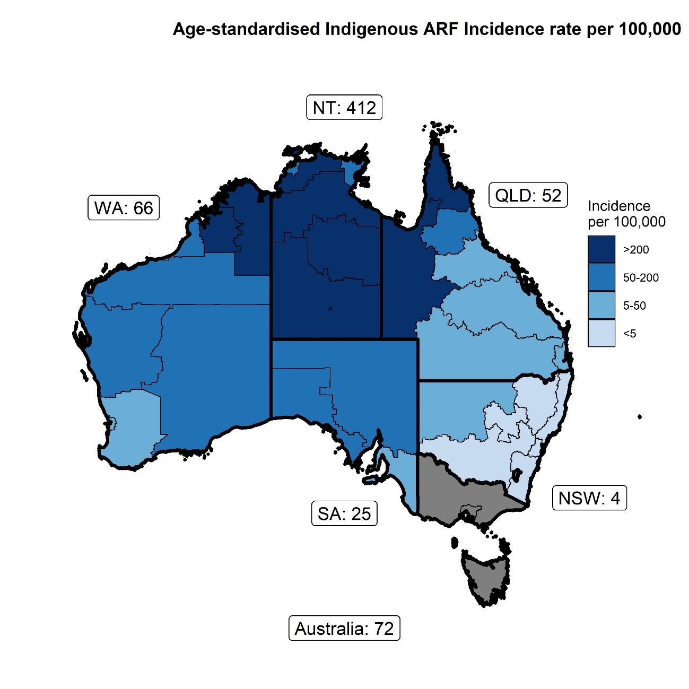
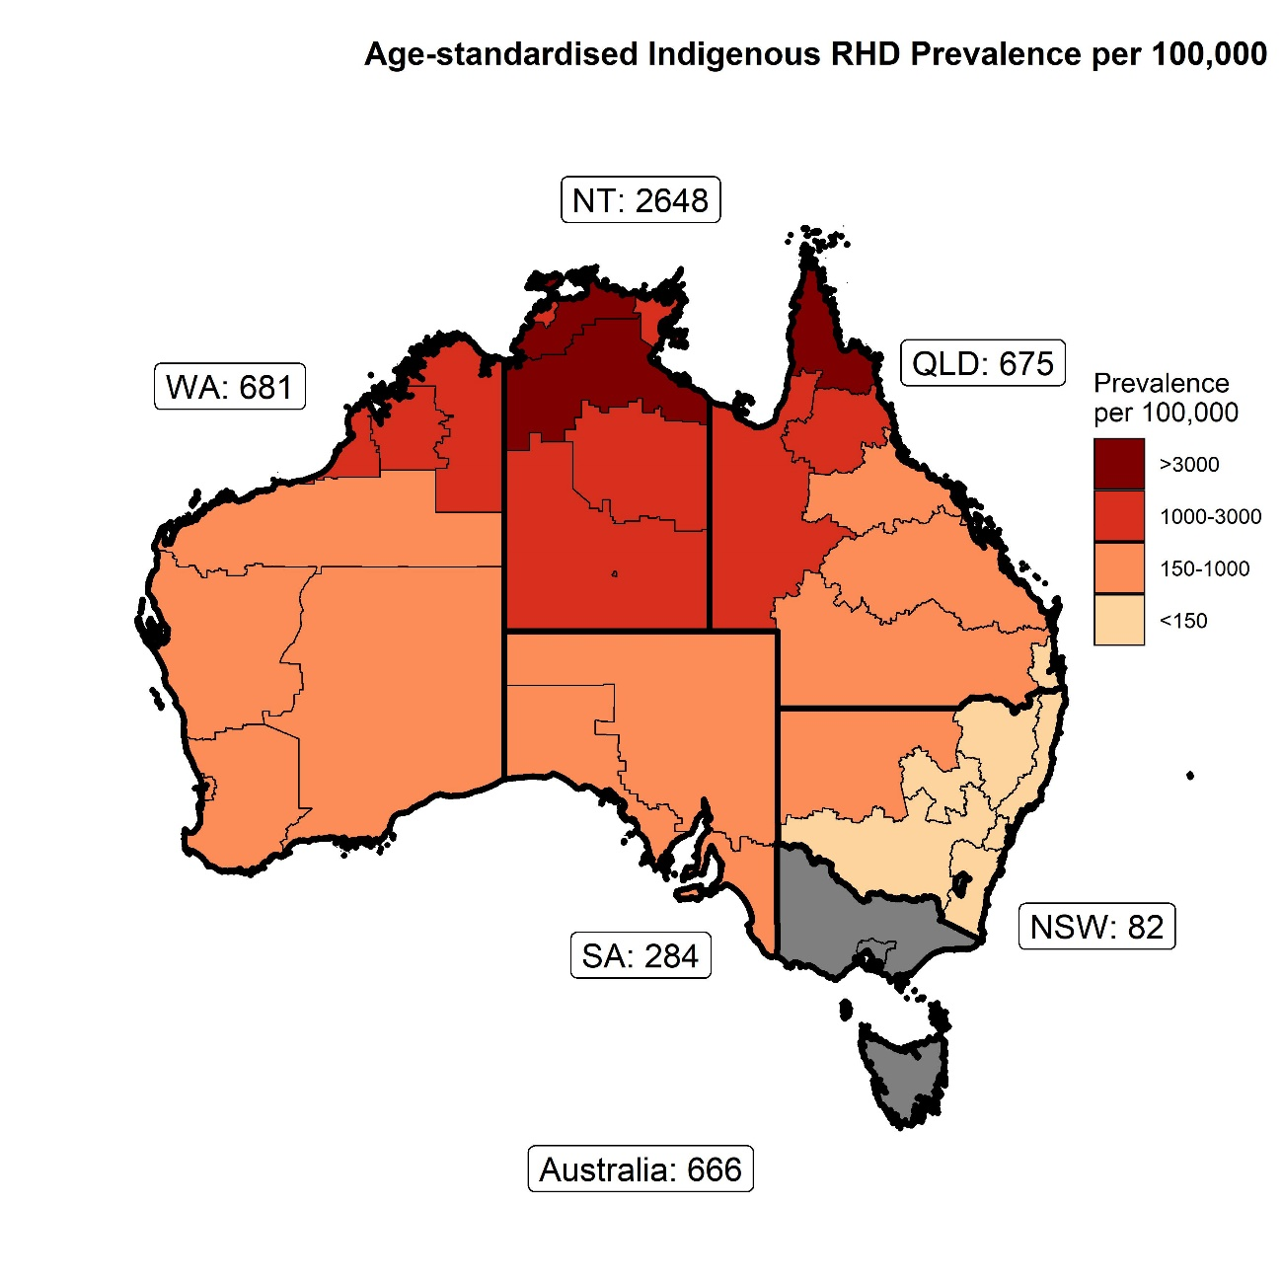
Age-standardised ARF Incidence rate
per 100,000 Indigenous (0-44y), 2015-2017
Age-standardised RHD prevalence
per 100,000 Indigenous (0-54y), 2015-2017
Katzenellenbogen JM, Bond-Smith D, Cunneen R, et al. Contemporary Incidence and Prevalence of Rheumatic Fever and Rheumatic Heart Disease in Australia Using Linked Data: The Case for Policy Change. Journal of the American Health Association. 2020; 9(19): e016851.
Katzenellenbogen JM, Bond-Smith D, Cunneen R, et al. The End Rheumatic Heart Disease in Australia Study of Epidemiology (ERASE) Project: data sources, case ascertainment and cohort profile. Clinical Epidemiology. 2019; 11:997-1010.
Notes:
INTERPRETATION
Age-standardised rates of a disease are summary population rates across age groups that account for differences in the age-structures of the populations being compared. Rates presented here are age-standardised.
These maps present the age-standardised incidence of ARF (left) and prevalence of RHD (right) for Aboriginal and Torres Strait Islander people living in Australia between 2015 and 2017. The colour gradient represents increasing incidence/prevalence with increasing darkness.
Incident ARF episodes include people with first-ever ARF diagnosis or recurrent episodes of ARF during a specific period.
ARF incidence (left map) represents the number of incident ARF episodes identified in Aboriginal and Torres Strait Islander people aged under 45 years in Australia between 2015 and 2017, per 100,000 of the Indigenous population (<45 years) in Australia at that time.
In Australia, the highest ARF incidence among Indigenous people is seen in the Northern Territory (412 per 100,000).
In Australia, the lowest ARF incidence among Indigenous people is seen in New South Wales (4 per 100,000).
The average ARF incidence among Indigenous people across Australia is 72 per 100,000.
RHD prevalence means the proportion of people living with RHD during a specific period.
RHD prevalence (right map) represents the number of Aboriginal and Torres Strait Islander people aged under 55 years who were living with RHD in New South Wales between 2015 and 2017, per 100,000 of the Indigenous population (<55 years) in New South Wales at that time.
In Australia, the highest RHD prevalence among Indigenous people is seen in the Northern Territory (2648 per 100,000).
In Australia, the lowest RHD prevalence among Indigenous people is seen in New South Wales (82 per 100,000).
The average RHD prevalence among Indigenous people across Australia is 666 per 100,000.

Slide 5
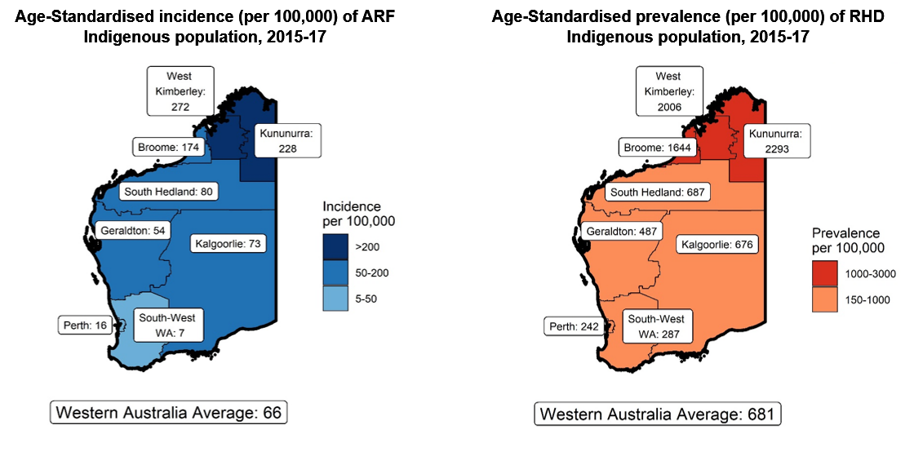
Katzenellenbogen JM, Bond-Smith D, Cunneen R, et al. Contemporary Incidence and Prevalence of Rheumatic Fever and Rheumatic Heart Disease in Australia Using Linked Data: The Case for Policy Change. Journal of the American Health Association. 2020; 9(19): e016851.
Katzenellenbogen JM, Bond-Smith D, Cunneen R, et al. The End Rheumatic Heart Disease in Australia Study of Epidemiology (ERASE) Project: data sources, case ascertainment and cohort profile. Clinical Epidemiology. 2019; 11:997-1010.
Notes:
INTERPRETATION
Age-standardised rates of a disease are summary population rates across age groups that account for differences in the age-structures of the populations being compared. Rates presented here are age-standardised.
These maps present the age-standardised incidence of ARF (left) and prevalence of RHD (right) for Aboriginal and Torres Strait Islander people living in Western Australia between 2015 and 2017. The colour gradient represents increasing incidence/prevalence with increasing darkness.
Incident ARF episodes include people with first-ever ARF diagnosis or recurrent episodes of ARF during a specific period.
The age-standardised ARF incidence (left map) represents the number of incident/ first-ever ARF episodes identified in Aboriginal and Torres Strait Islander people aged under 45 years in Western Australia between 2015 and 2017, per 100,000 of the Indigenous population (<45 years) in Western Australia at that time.
In Western Australia, the highest ARF incidence among Indigenous people is seen in the West Kimberley (272 people per 100,000) and Kununurra regions (228 per 100,000).
In Western Australia, the lowest ARF incidence among Indigenous people is seen in the South-West region (7 per 100,000).
The average ARF incidence among Indigenous people across Western Australia is 66 per 100,000.
RHD prevalence means the proportion of people living with RHD during a specific period.
The age-standardised RHD prevalence (right map) represents the number of Aboriginal and Torres Strait Islander people aged under 55 years who were living with RHD in Western Australia between 2015 and 2017, per 100,000 of the Indigenous population (<55 years) in Western Australia at that time.
In Western Australia, the highest RHD prevalence among Indigenous people is seen in the Kununurra (2293 people per 100,000), West Kimberley (2006 per 100,000) and Broome regions (1644 people per 100,000).
In Western Australia, the lowest RHD prevalence among Indigenous people is seen in the Perth metro region (242 per 100,000).
The average RHD prevalence among Indigenous people across Western Australia is 681 per 100,000.

Slide 6
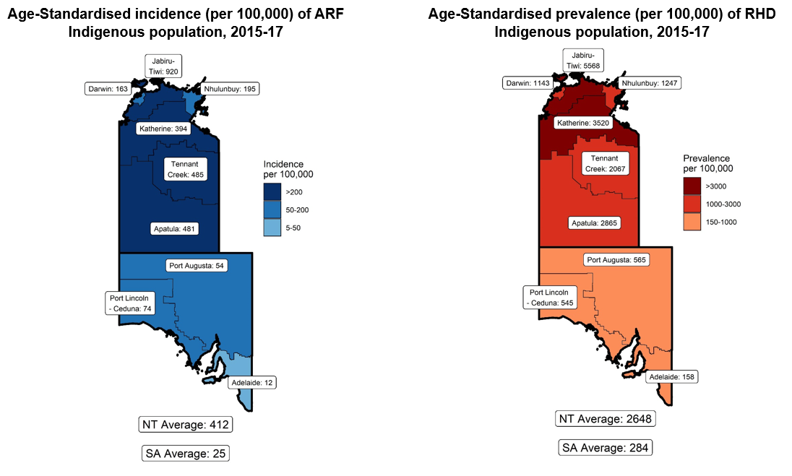
Katzenellenbogen JM, Bond-Smith D, Cunneen R, et al. Contemporary Incidence and Prevalence of Rheumatic Fever and Rheumatic Heart Disease in Australia Using Linked Data: The Case for Policy Change. Journal of the American Health Association. 2020; 9(19): e016851.
Katzenellenbogen JM, Bond-Smith D, Cunneen R, et al. The End Rheumatic Heart Disease in Australia Study of Epidemiology (ERASE) Project: data sources, case ascertainment and cohort profile. Clinical Epidemiology. 2019; 11:997-1010.
Notes:
INTERPRETATION
Age-standardised rates of a disease are summary population rates across age groups that account for differences in the age-structures of the populations being compared. Rates presented here are age-standardised.
These maps present the age-standardised incidence of ARF (left) and prevalence of RHD (right) for Aboriginal and Torres Strait Islander people living in South Australia and the Northern Territory (combined) between 2015 and 2017. The colour gradient represents increasing incidence/prevalence with increasing darkness.
Incident ARF episodes include people with first-ever ARF diagnosis or recurrent episodes of ARF during a specific period.
The age-standardised ARF incidence (left map) represents the number of incident ARF episodes identified in Aboriginal and Torres Strait Islander people aged under 45 years in South Australia and the Northern Territory (combined) between 2015 and 2017, per 100,000 of the Indigenous population (<45 years) in these jurisdictions at that time.
In the Northern Territory, the highest ARF incidence among Indigenous people is seen in the Jabiru-Tiwi region (920 per 100,000).
In the Northern Territory, the lowest ARF incidence among Indigenous people is seen in the Darwin region (163 per 100,000).
The average ARF incidence among Indigenous people across the Northern Territory is 412 per 100,000.
In South Australia, the highest ARF incidence among Indigenous people is seen in the Port Lincoln-Ceduna region (74 per 100,000).
In South Australia, the lowest ARF incidence among Indigenous people is seen in the Adelaide region (12 per 100,000).
The average ARF incidence among Indigenous people across South Australia is 25 per 100,000.
RHD prevalence means the proportion of people living with RHD during a specific period.
The age-standardised RHD prevalence (right map) represents the number of Aboriginal and Torres Strait Islander people living with RHD in South Australia and the Northern Territory (combined) between 2015 and 2017, per 100,000 of the Indigenous population in these jurisdictions at that time.
In the Northern Territory, the highest RHD prevalence among Indigenous people is seen in the Jabiru-Tiwi region (5568 per 100,000).
In the Northern Territory, the lowest RHD prevalence among Indigenous people is seen in the Darwin region (1143 per 100,000).
The average RHD prevalence among Indigenous people across the Northern Territory is 2648 per 100,000.
In South Australia, the highest RHD prevalence among Indigenous people is seen in the Port Augusta region (565 per 100,000).
In South Australia, the lowest RHD prevalence among Indigenous people is seen in the Adelaide region (158 per 100,000).
The average RHD prevalence among Indigenous people across South Australia is 284 per 100,000.

Slide 7
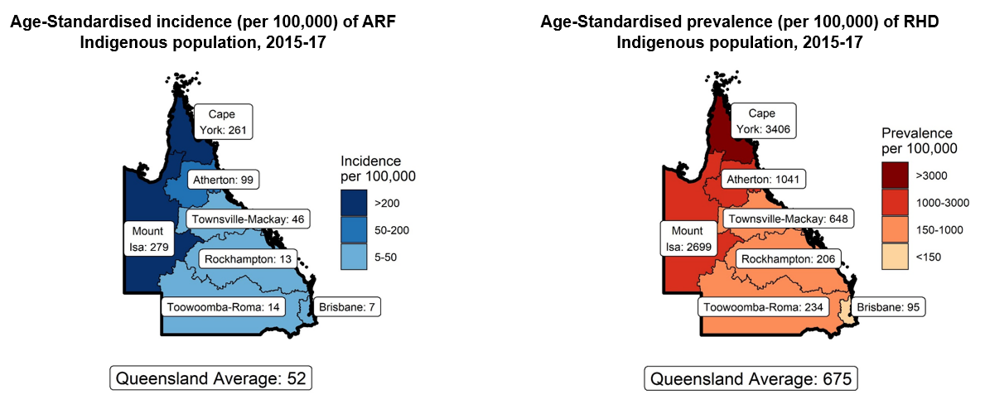
Katzenellenbogen JM, Bond-Smith D, Cunneen R, et al. Contemporary Incidence and Prevalence of Rheumatic Fever and Rheumatic Heart Disease in Australia Using Linked Data: The Case for Policy Change. Journal of the American Health Association. 2020; 9(19): e016851.
Katzenellenbogen JM, Bond-Smith D, Cunneen R, et al. The End Rheumatic Heart Disease in Australia Study of Epidemiology (ERASE) Project: data sources, case ascertainment and cohort profile. Clinical Epidemiology. 2019; 11:997-1010.
Notes:
INTERPRETATION
Age-standardised rates of a disease are summary population rates across age groups that account for differences in the age-structures of the populations being compared. Rates presented here are age-standardised.
These maps present the age-standardised incidence of ARF (left) and prevalence of RHD (right) for Aboriginal and Torres Strait Islander people living in Queensland between 2015 and 2017. The colour gradient represents increasing incidence/prevalence with increasing darkness.
Incident ARF episodes include people with first-ever ARF diagnosis or recurrent episodes of ARF during a specific period.
The age-standardised ARF incidence (left map) represents the number of incident ARF episodes identified in Aboriginal and Torres Strait Islander people aged under 45 years in Queensland between 2015 and 2017, per 100,000 of the Indigenous population (<45 years) in Queensland at that time.
In Queensland, the highest ARF incidence among Indigenous people is seen in the Mount Isa region (279 per 100,000).
In Queensland, the lowest ARF incidence among Indigenous people is seen in the Brisbane region (7 per 100,000).
The average ARF incidence among Indigenous people across Queensland is 52 per 100,000.
RHD prevalence means the proportion of people living with RHD during a specific period.
The age-standardised RHD prevalence (right map) represents the number of Aboriginal and Torres Strait Islander people aged under 55 years who were living with RHD in Queensland between 2015 and 2017, per 100,000 of the Indigenous population (<55 years) in Queensland at that time.
In Queensland, the highest RHD prevalence among Indigenous people is seen in the Cape York region (3406 per 100,000).
In Queensland, the lowest RHD prevalence among Indigenous people is seen in the Brisbane region (95 per 100,000).
The average RHD prevalence among Indigenous people across Queensland is 675 per 100,000.

Slide 8
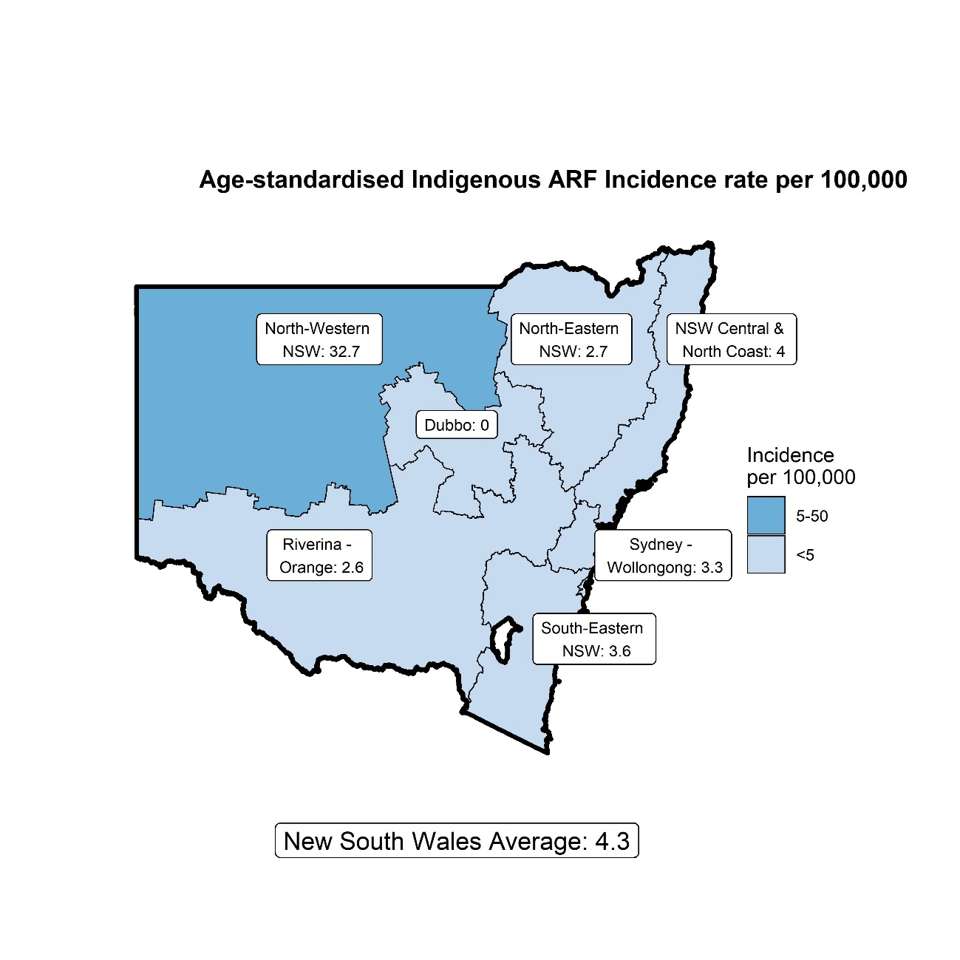
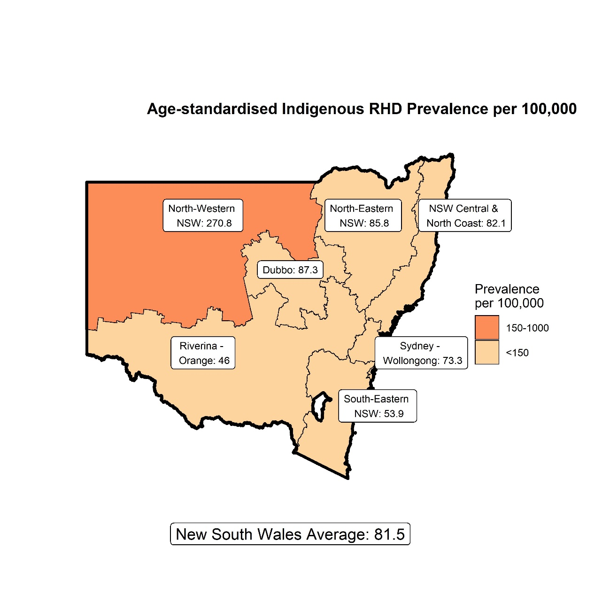
Katzenellenbogen JM, Bond-Smith D, Cunneen R, et al. Contemporary Incidence and Prevalence of Rheumatic Fever and Rheumatic Heart Disease in Australia Using Linked Data: The Case for Policy Change. Journal of the American Health Association. 2020; 9(19): e016851.
Katzenellenbogen JM, Bond-Smith D, Cunneen R, et al. The End Rheumatic Heart Disease in Australia Study of Epidemiology (ERASE) Project: data sources, case ascertainment and cohort profile. Clinical Epidemiology. 2019; 11:997-1010.
Notes:
INTERPRETATION
Age-standardised rates of a disease are summary population rates across age groups that account for differences in the age-structures of the populations being compared. Rates presented here are age-standardised.
These maps present the age-standardised incidence of ARF (left) and prevalence of RHD (right) for Aboriginal and Torres Strait Islander people living in Queensland between 2015 and 2017. The colour gradient represents increasing incidence/prevalence with increasing darkness.
Incident ARF episodes include people with first-ever ARF diagnosis or recurrent episodes of ARF during a specific period.
ARF incidence (left map) represents the number of incident ARF episodes identified in Aboriginal and Torres Strait Islander people aged under 45 years in New South Wales between 2015 and 2017, per 100,000 of the Indigenous population (<45 years) in New South Wales at that time.
In New South Wales, the highest ARF incidence among Indigenous people is seen in the North-Western region (33 per 100,000).
In New South Wales, the lowest ARF incidence among Indigenous people is seen in the Dubbo region (0 per 100,000).
The average ARF incidence among Indigenous people across New South Wales is 4 per 100,000.
RHD prevalence means the proportion of people living with RHD during a specific period.
The age-standardised RHD prevalence (right map) represents the number of Aboriginal and Torres Strait Islander people aged under 55 years who were living with RHD in New South Wales between 2015 and 2017, per 100,000 of the Indigenous population (<55 years) in New South Wales at that time.
In New South Wales, the highest RHD prevalence among Indigenous people is seen in the North-Western region (271 per 100,000).
In New South Wales, the lowest RHD prevalence among Indigenous people is seen in the Riverina-Orange region (46 per 100,000).
The average RHD prevalence among Indigenous people across New South Wales is 82 per 100,000.

