Slide 1
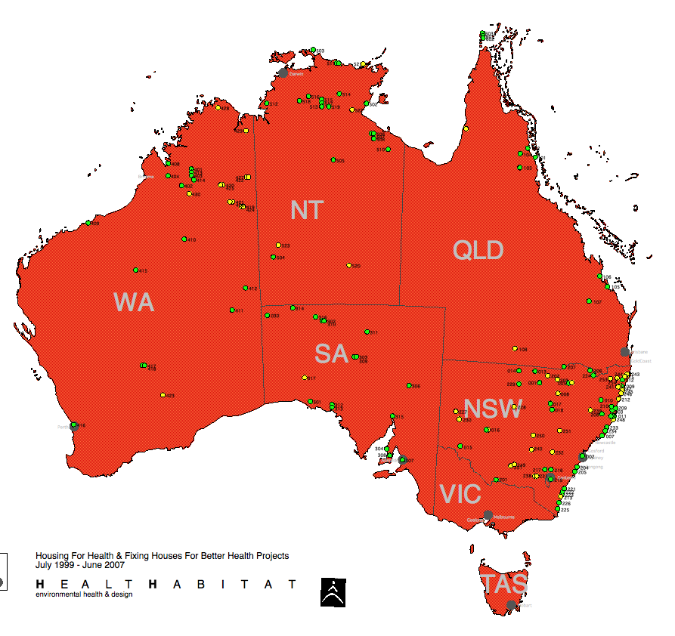
218
8,466
58,500
Update
projects / houses / people people

Slide 2
to improve
living conditions
2017 - the % of 8,466 houses functioning before fix work:
10%
Electrically safe
37%
A working shower
6%
A working kitchen

Slide 3
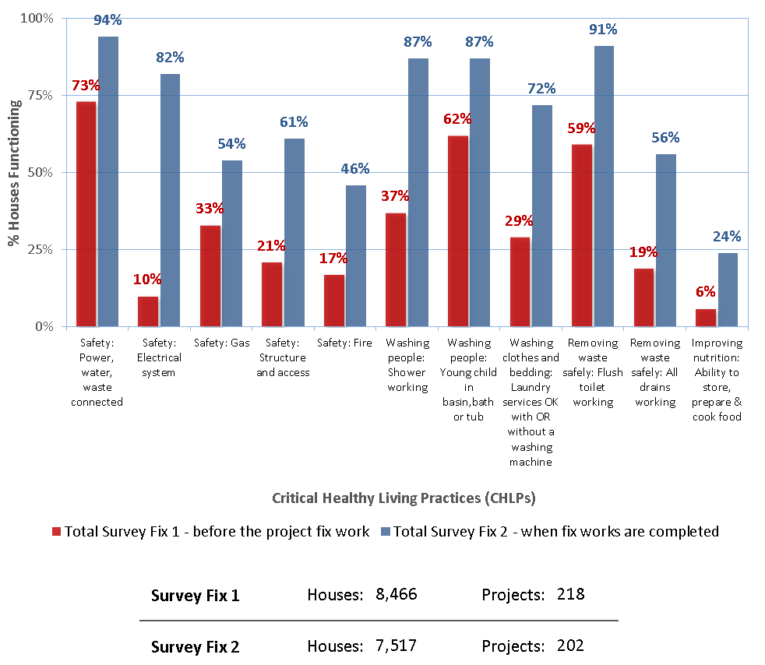
Critical Healthy Living Practices

Slide 4
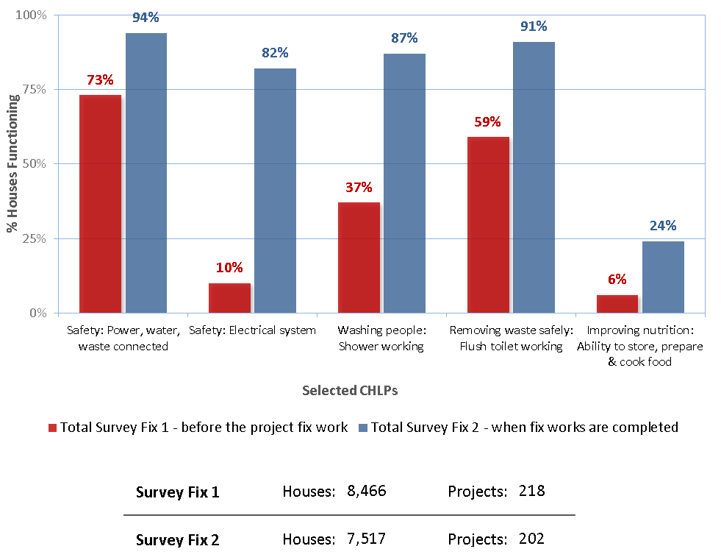
Critical Healthy Living Practices

Slide 5
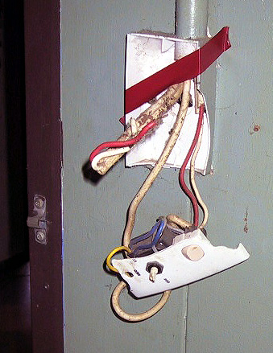
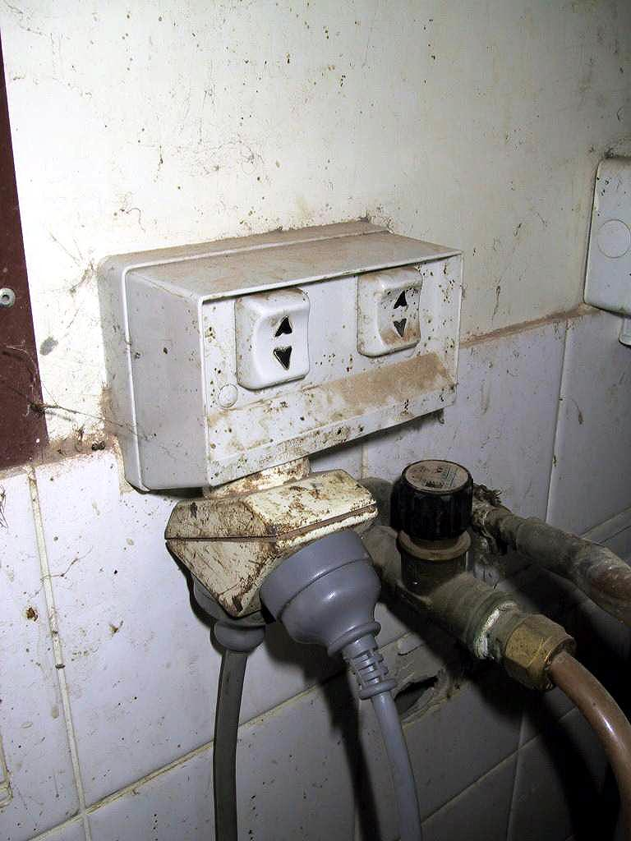
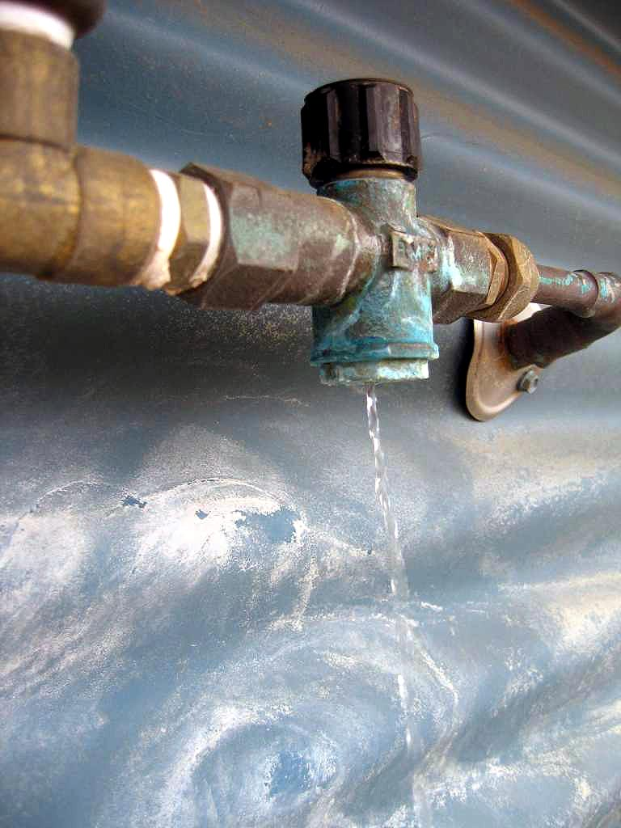
8%
19%
73%
Damage?
by the residents
Faulty?
poor construction
Routine?
normal wear
264,460+ items fixed or inspected

Slide 6
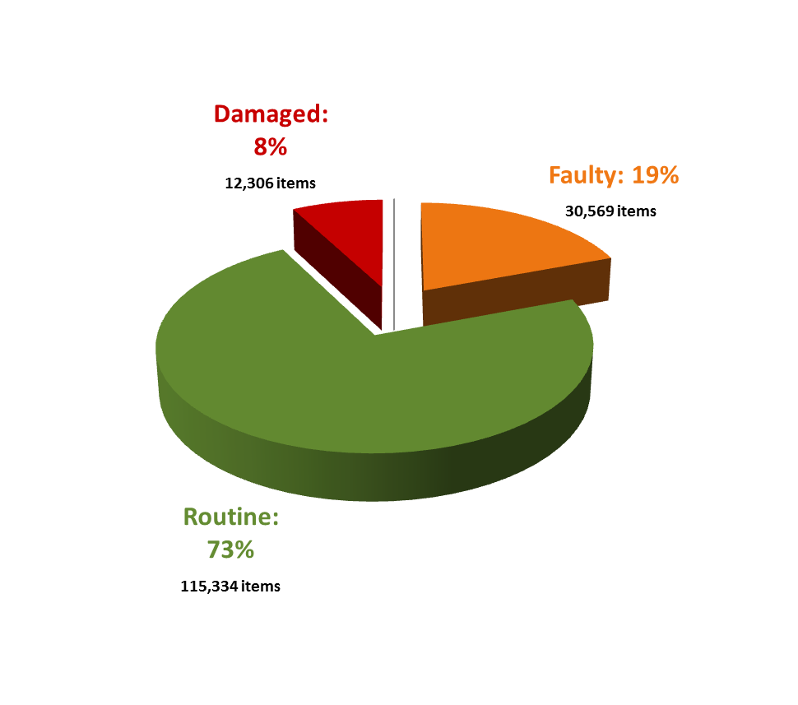
ALL fixwork

Slide 7
Community Staff % - employed for SF1 , Capital Upgrade Program and SF2

