Slide 1

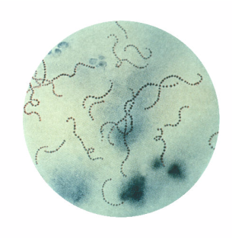
Primary Prevention
RHDA SA workshop March 2017
Menzies School Health Research
Claire Boardman
Deputy Director, RHDAustralia
BN, Cert IC, MPH, CICP, Senior Lecturer Griffith University Qld.
Streptococcus pyogenes bacteria, Pappenheim’s stain

Slide 2
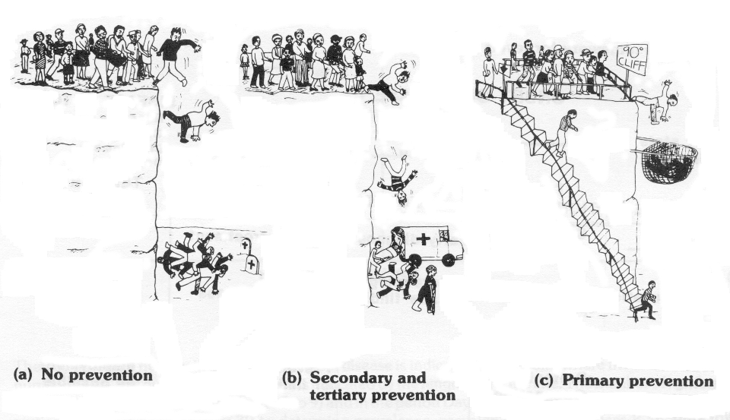
LEVELS of PREVENTION

Slide 3
PRIMORDIAL PREVENTION
Prevention of a disease should go beyond primary prevention to include activities that prevent the introduction of risk factors into a population (Strasser WHO 1978)
Broad initiatives that prevent or limit the impact of GAS infection in a population
Improvement of environmental, social, and economic conditions of populations at risk of RF and RHD

Slide 4

PRIMARY HEALTHCARE MODEL –
1978 WHO ALMA ATA DECLARATION
  Social approach to health founded on human rights framework
  Based on economic and social justice
  Affordable, accessible, appropriate
  Considers culture, environment, ethnicity
  SOCIAL DETERMINANTS OF HEALTH INCLUDE:
  Stress
  Social exclusion
  Unemployment
  Addiction
  Availability of healthy food
  Availability of healthy transportation
  Social support networks
  Early childhood development
  Social gradients (shorter life expectancy,
  the poorer you are > disease risk)

Slide 5
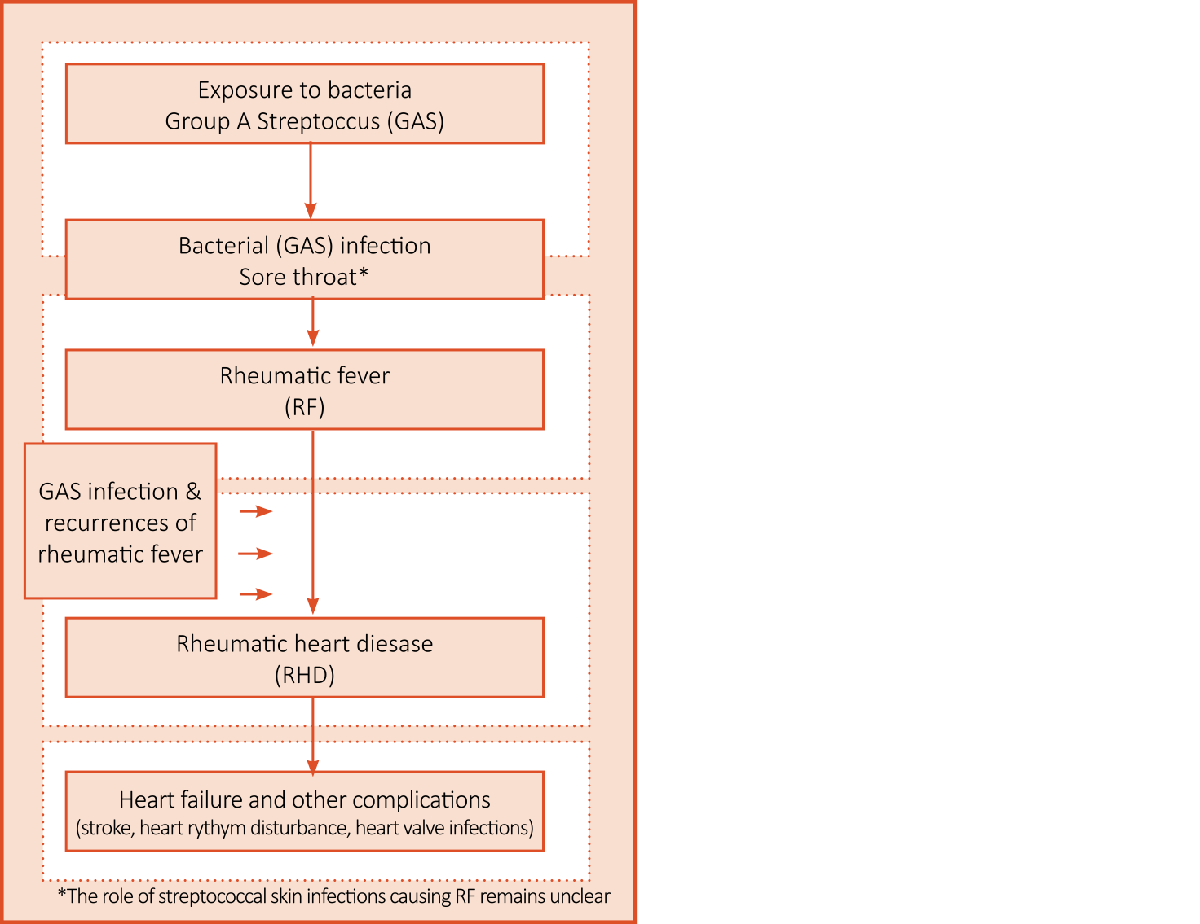
1. Burden of disease
2. Exposure to GAS
3. Response to GAS infection
4. Diagnosis and management of sore throat
5. Diagnosis of ARF
6. Prevention of ARF recurrence
7. Early diagnosis of RHD
8. RHD in Pregnancy
9. Medical management
10. Surgical care for RHD

Slide 6
THE ARF/RHD PATHWAY
Stop development of risk factors
Prevent GAS infections
Target populations at risk
Stop sore throats* & manage skin sores
Diagnose & manage ARF
Secondary Px with BPG
Adherence rates
Surgical intervention
Valve replacement
PRIMORDIAL
PRIMARY
SECONDARY
TERTIARY
Noonan et al 2012: renewed emphasis on treatment of sore throat in high-risk groups.

Slide 7
Preventing ARF and RHD
PRIMORDIAL
Address risk factors
PRIMARY
Sore throat rx
Skin sore rx
GAS vaccine
GAS infection
SECONDARY
Regular penicillin
SECONDARY
Regular penicillin
Prevent recurrence of ARF
ARF
SECONDARY
Regular penicillin
Often prolonged asymptomatic period of RHD
RHD
TERTIARY
HF medication
Surgery
Anti-coagualtion
Cardiac surgery
Stroke, endocarditis
Death
Notes:
7

Slide 8

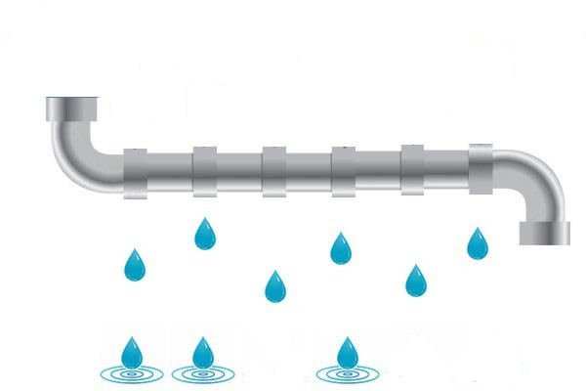




The RHD Pipeline
NOTIFY
Specialist
Injection care
Review
Echo
Education
Reminders
DISCHARGE
Courtesy – Steven Donoghue

Slide 9
Throat and skin and ARF and APSGN
ARF
?
?
Skin GAS
Throat GAS
? priming
APSGN

Slide 10
Pathogenesis of ARF
Organism factor(s)
(“Rheumatogenicity”)
Host factor(s)
(Genetic susceptibility)
Abnormal immune response
Acute rheumatic fever

Slide 11
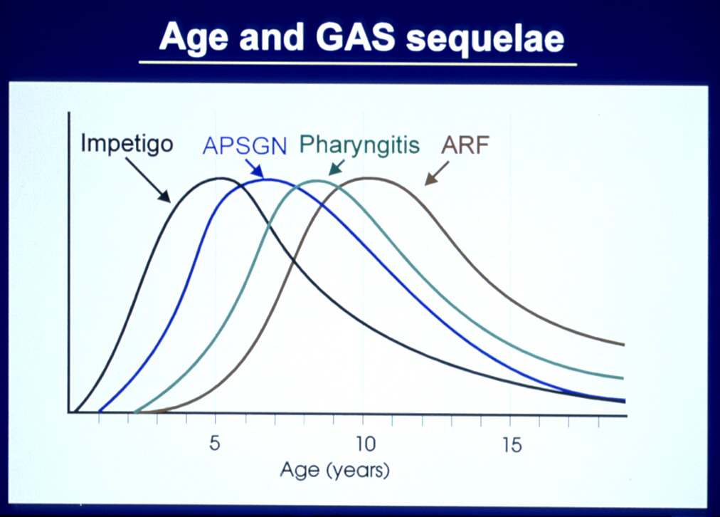
Age and Gp A streptococcal sequelae
At what point does exposure to the rheumatogenic strain occur?

Slide 12
GENETICS STUDY

Slide 13
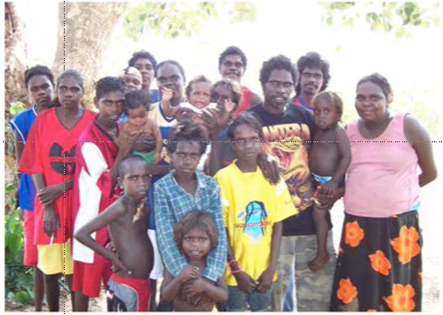
Primordial prevention
At each level
Populations
Communities
Families
Households

Slide 14
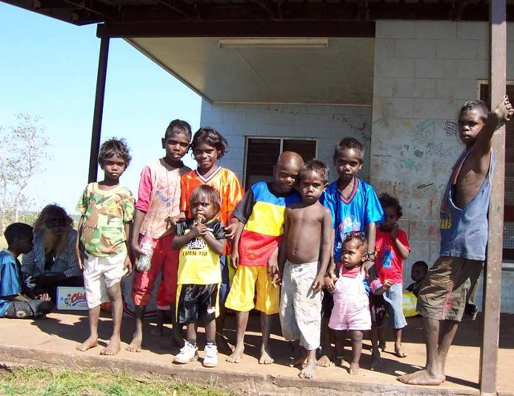
Primordial prevention of ARF/RHD
Housing
Education
Employment
Communications
Transport & access to services

Slide 15
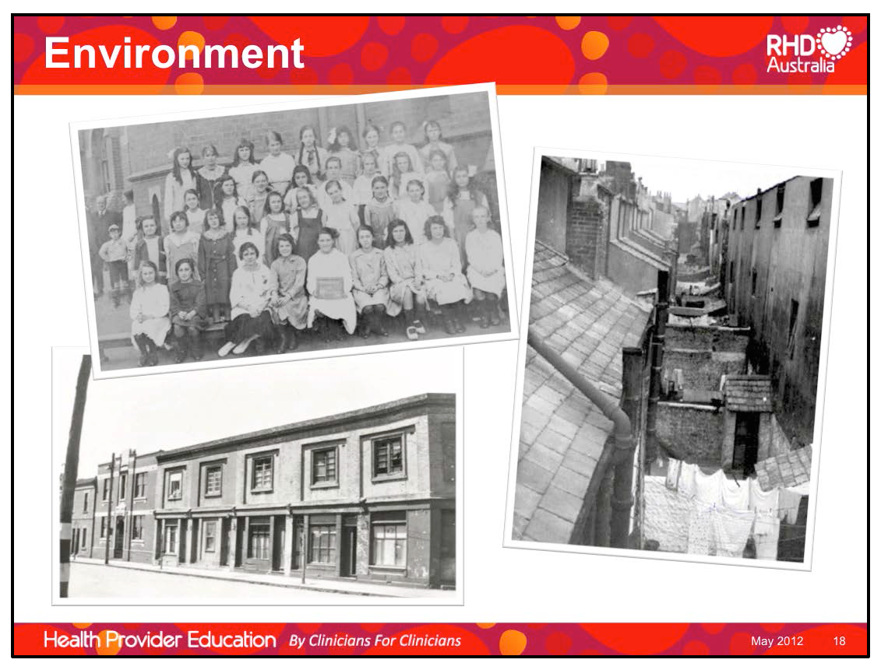

Slide 16
GAS Transmission and Crowding
Warren Air Force Base, Wyoming USA
Bed distance from ‘colonised’ barracks mate correlated with GAS acquisition
0-5 feet > 60 GAS acquisitions/100,000 man weeks
> 30 feet < 20 GAS acquisitions/100,000 man weeks
        Wannamaker LW. 1954

Slide 17
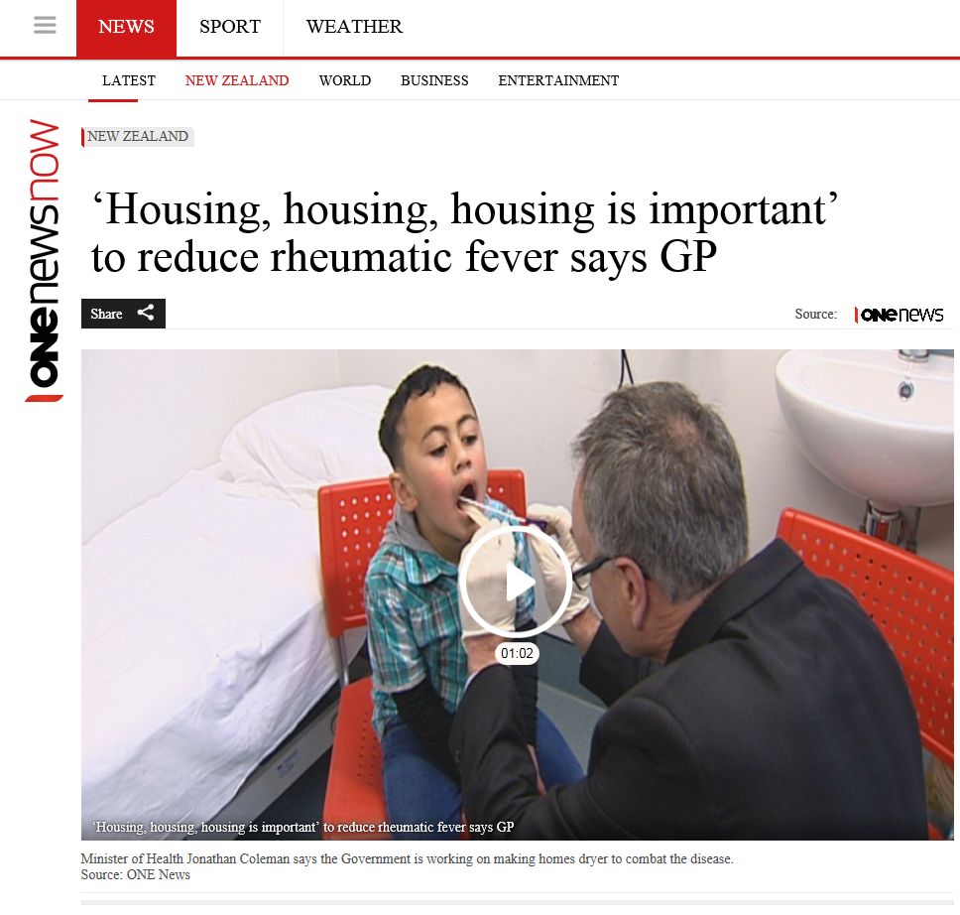

Slide 18
The Big Picture
“ Now, I keep saying that I don’t care what colour you are or where you come from, but if you’re living in a small house with large numbers of people, then you’re going to get sick.”
Puggy Hunter, NACCHO Chairman, 2001
Notes:
Puggy died 50yo 2001

Slide 19
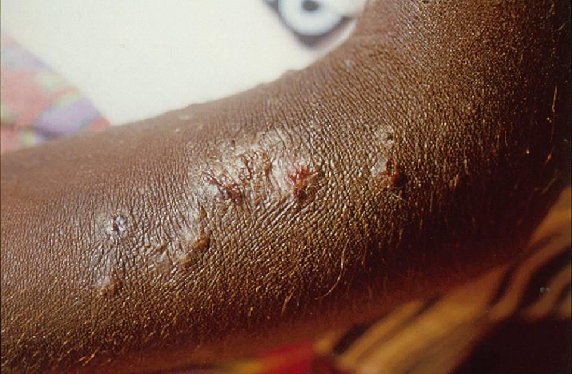
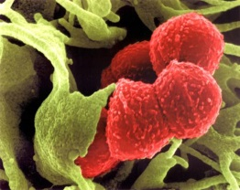
Pyoderma and crowding

Slide 20
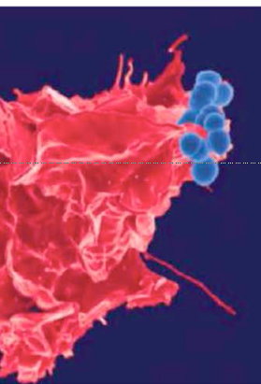
Primary prevention
Stopping GAS infection occurring in first place
OR
If infection happens stopping GAS infection leading to ARF
HOW?
Notes:
Puggy died 50yo 2001

Slide 21
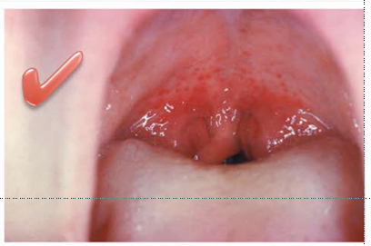
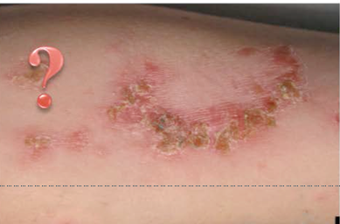
Stopping GAS infection
In the throat (pharyngitis) or
On the skin (pyoderma)
Notes:
Puggy died 50yo 2001

Slide 22
Primary Prevention of ARF/RHD
Prophylactic antibiotics for GAS
Treating GAS pharyngitis
Treating GAS pyoderma?
A GAS vaccine

Slide 23
Primary prevention of pyoderma – what works?
Hand washing – can it become routine and sustainable?
Swimming pools – positive reports but confounders
Treatment of scabies – directed and mass treatment – Galiwin’ku trial
Community campaigns and healthy skin days – Wadeye and East Arnhem data
BPG in APSGN outbreaks – stop GAS transmission?
Vaccines – for GAS and scabies; imminent??

Slide 24

www.nt.gov.au/health/cdc

Slide 25
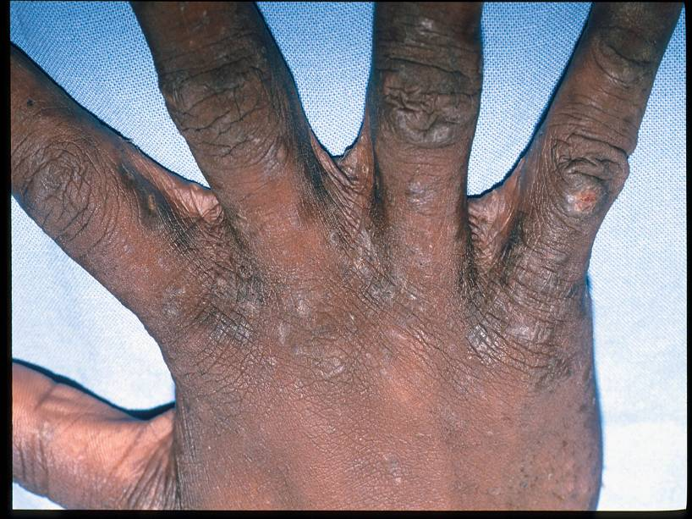
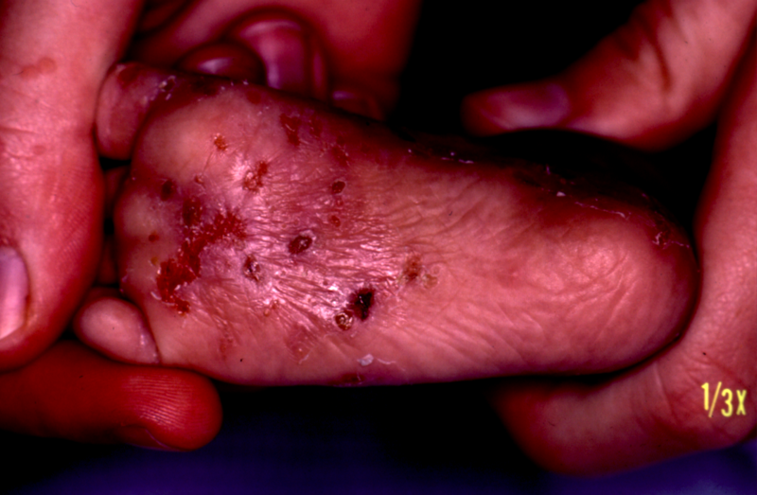
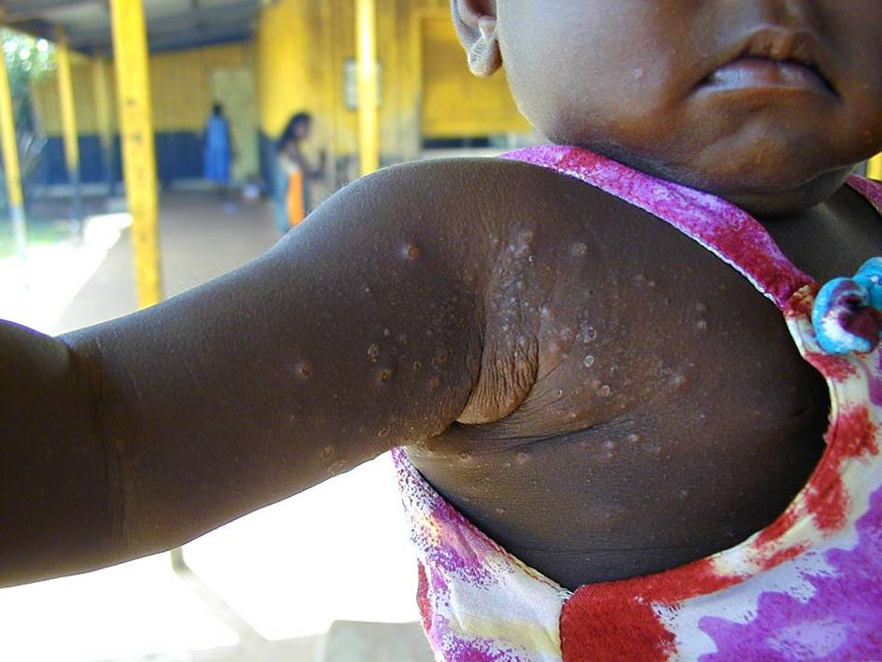
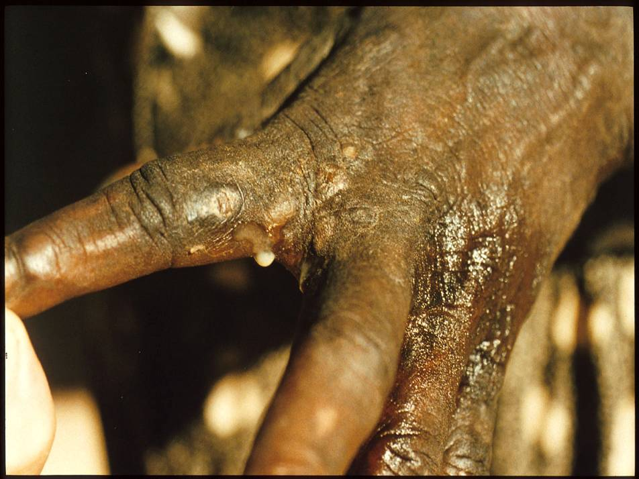
Scabies

Slide 26
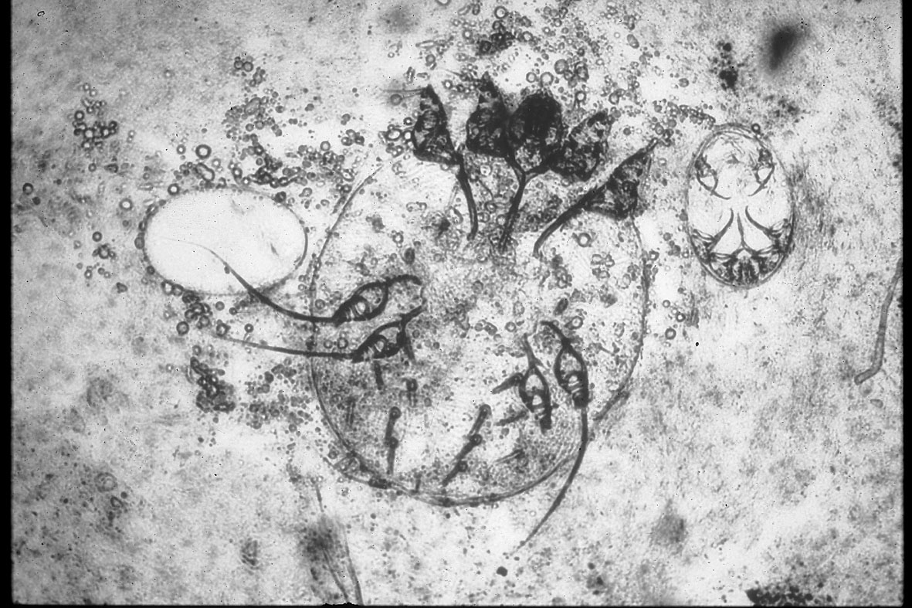
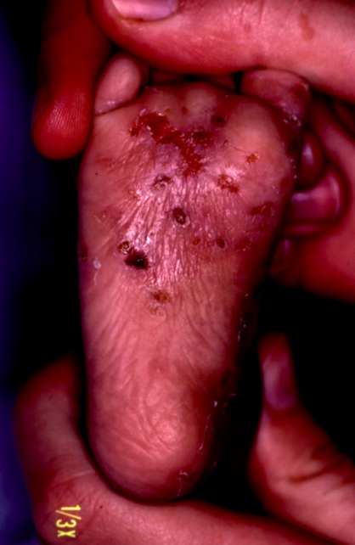
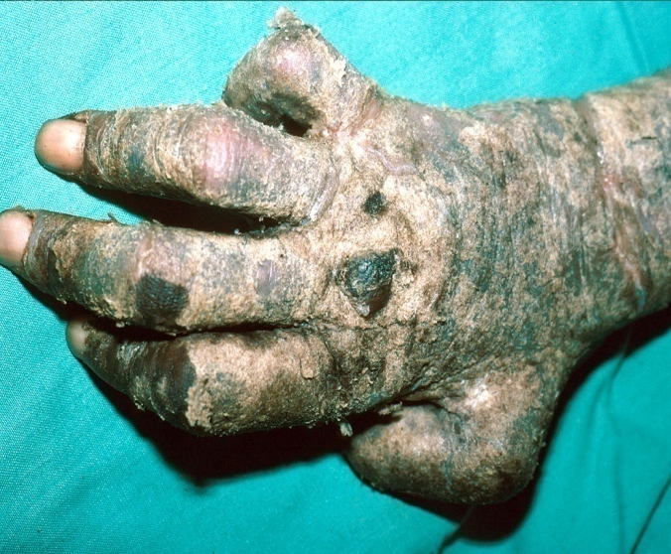
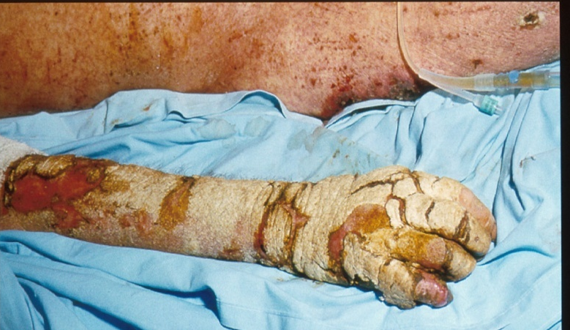
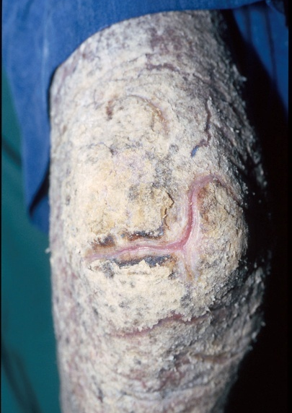
Why is scabies so hard to eradicate?
1
2
3
3
3
4: population mobility

Slide 27
What we know we don’t know
Who are the “3-6%” susceptible?
  what is the genetic basis of this?
What is the immunopathogenetic process?
  we need a diagnostic blood test for ARF
Which Gp A strep emm types – how restricted?
  what about GCS and GGS (horizontal gene transfer)?
What have skin GAS got to do with it?
How to make primordial prevention a reality?
How to best choose when to Tx “throats”
What is the optimum preparation & dosing of BPG?
How do we optimise secondary prophylaxis?
  dosing, intervals, adherence, pain, site, i-fat?

Slide 28
Take home messages
ARF/RHD are immune mediated manifestations of GAS
The site of preceding GAS infection is throat (proven) and/or skin (less certain)
Ultimate goal is primordial prevention
Currently primary prevention consists of treating symptomatic pharyngitis with antibiotics (especially in high-risk populations)
Address skin infections
BEWARE the BOILED FROG/NORMALISATION ANALOGY

