Slide 1
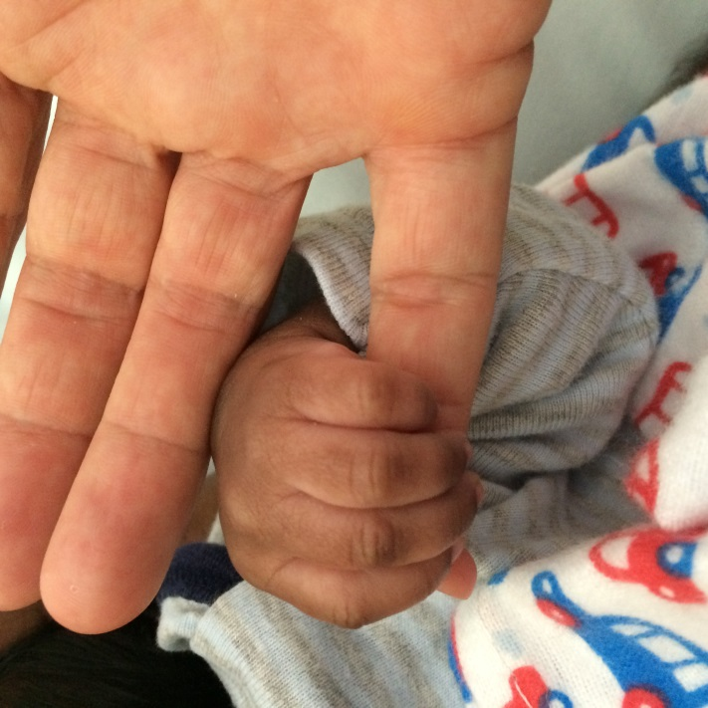
Rheumatic heart disease and ‘Women’s business’ SAHMRI March 2017 Associate Professor Suzanne Belton Principal Research Fellow, RHDAustralia

Slide 2
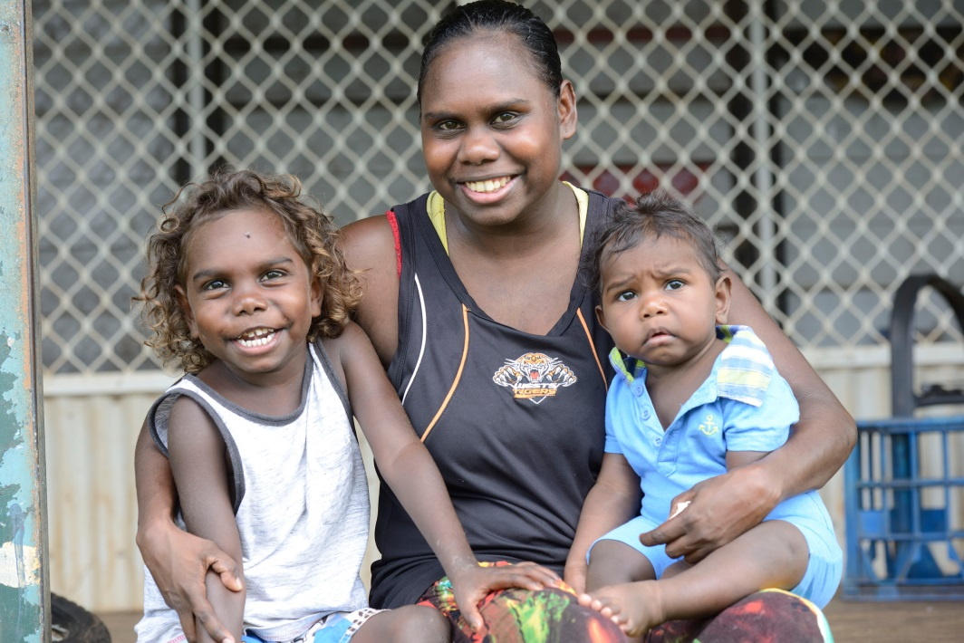
Each year 100 women are pregnant and have RHD
Some women are diagnosed with RHD during the pregnancy
They often have complex health and social needs
Most women and babies survive

Slide 3
Cardiac profile & assessment of women giving birth with RHD
 | Indigenous No (%) | Other No (%)
Aortic/mitral stenosis present at booking visit | 60 (40.3) | 23 (57.5)
Echo during pregnancy | 131 (87.9) | 38 (95.0)
Diagnosed pre-pregnancy | 131 (87.9) | 36 (90.0)
Diagnosed during pregnancy | *16 (10.7) | 4 (10.0)

Slide 4
Sylvia
22 years old
Aboriginal woman pregnant with first baby
Lives in small remote community in the Northern Territory – very crowded house
Persistent cough - smoker
Heart murmur at 18 weeks – echo 14 weeks later
Increasing breathlessness with gestation
Commenced diuretic and beta-blocker
No paid employment - food security problem
Partner abusive
Speaks several local languages and English is not flash

Slide 5
Sylvia said:
‘My feet have been swollen for a few weeks. My heart was beating fast. I had to get an x-ray of my chest. (She moved her hand to her chest, upset.) I didn’t know what was wrong with my heart – they didn’t tell me. I had a kidney problem when I was a baby. Now I have RHD. But I don’t really know what that means. A lady tried to explain it to me but I don’t know what that needle does. I don’t feel breathless now because I take my tablets.’

Slide 6
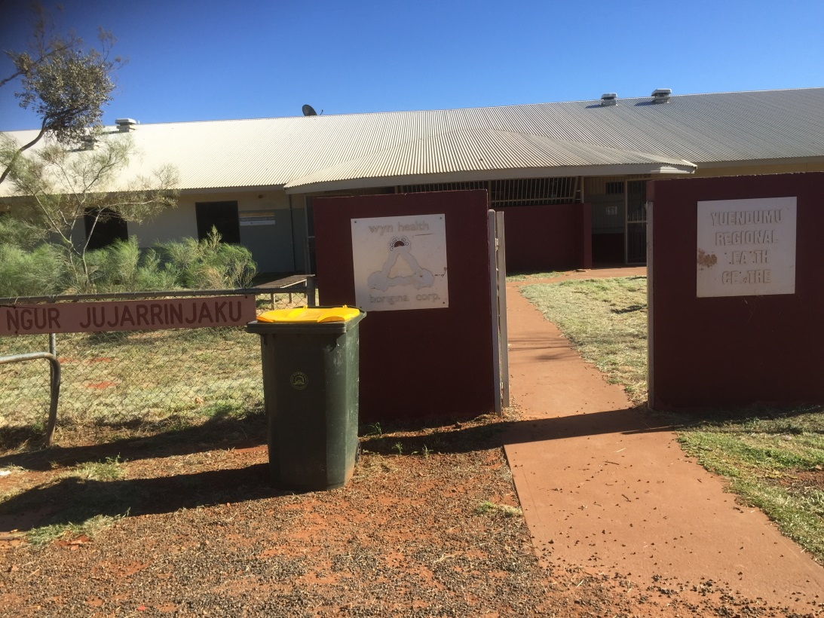
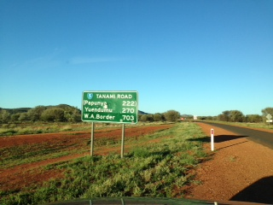
A drive to get to the plane to get to the regional hospital … for an echocardiogram

Slide 7
Sylvia's patient journey
Sylvia likes her remote area midwife ‘Sarah’
Sylvia is transferred to the regional hospital in Darwin
Sylvia is flown interstate to deliver her baby at Flinders Medical Centre
At 38 weeks’ gestation, Sylvia had an emergency caesarean as a result of her heart failure and gave birth to a baby boy.

Slide 8
Having baby and returning home…
Sylvia was distressed: ‘I have to go home by myself. The police came and took him (partner Steven) to the station, he is in trouble. He missed court.’ Sylvia sobbed.
As Sylvia went into labour, Steven was arrested and jailed for assaulting her earlier in pregnancy. This serious assault was documented in the case notes but no health staff had discussed it with Sylvia or made a safety plan for her and the baby.

Slide 9
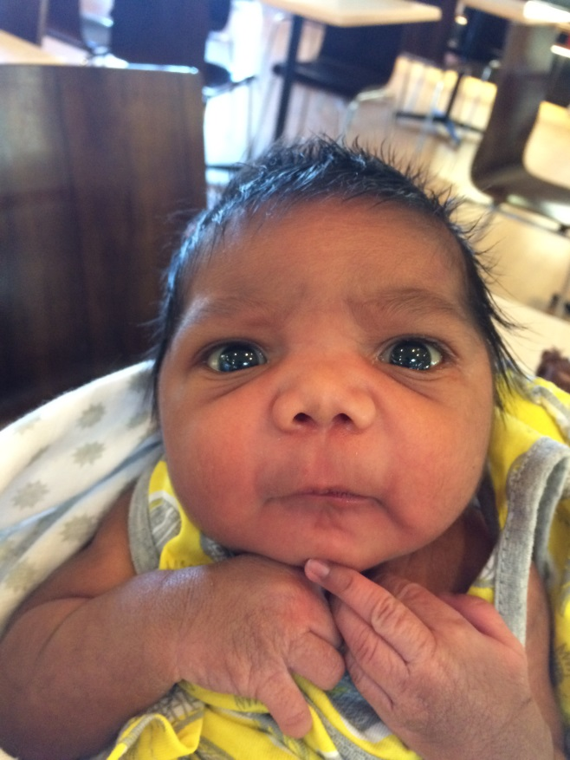
Postnatal care
One week after the birth, Sylvia was flown home. The discharge summary was sent to the wrong community, Sylvia’s medications were not provided and no postnatal recall appointments were set up.
The primary health care team was not aware she had arrived home. Her next LABicillin secondary prophylaxis injection was late.
Back home Sylvia was breastfeeding her baby.
She was surrounded by aunties and cousins who
played with him. He had big eyes and snuggled into
his mum. She thought she might like another baby
soon….

Slide 10
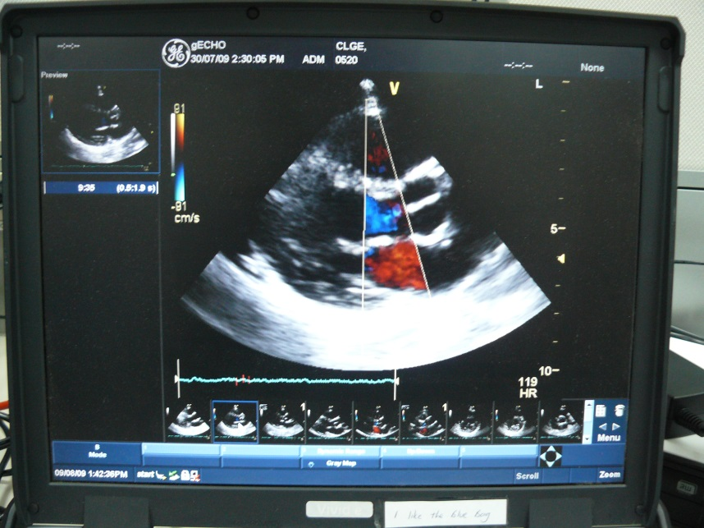
Caring for Sylvia
Who needs to be involved with Sylvia’s care?
What issues seem to be the most important to Sylvia?
How do you think you can look after Sylvia?

Slide 11
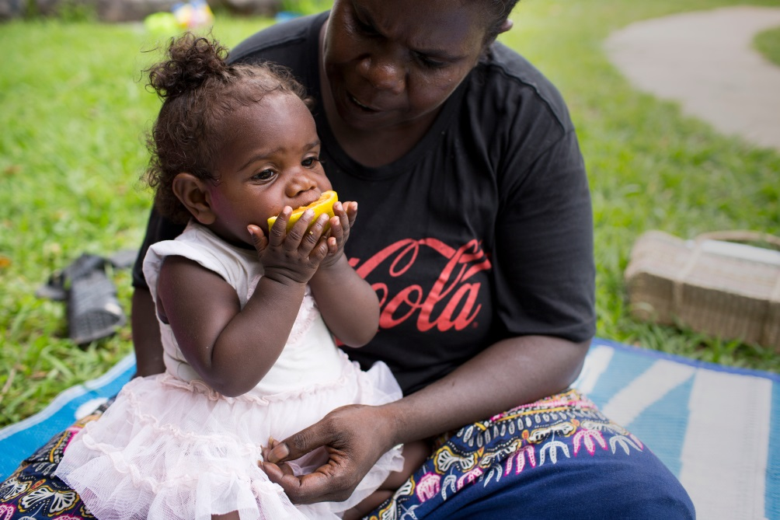
Best practice the 6 Cs
Clinical knowledge
Cultural competency
Continuity of care and coordination
Consent
Complete care
(social/psycho/education)
Contraception
Notes:
ccccccc

Slide 12
Our Vision
Quiz
RHD is a common congenital heart condition that is equally prevalent in all levels of society and in all geographic areas.
True/ false ?
Sylvia has had ARF in the past; she should understand the causes and consequences of RHD!
Sylvia says yes to everything the health staff ask her so that means she must understand.
Our Mission
To prevent and reduce acute rheumatic fever and rheumatic disease in Australia
Sylvia has multiple issues impacting on her care and health outcomes that the health care team should address.
Responsive, innovative, integrity, quality, evidence based, collaborative
What were the 6 Cs?
LA Bicillin should not be given during pregnancy.
Women who have had cardiac surgery and new valves should not get pregnant.
Long acting reversible contraceptives are safe for women with RHD

Slide 13
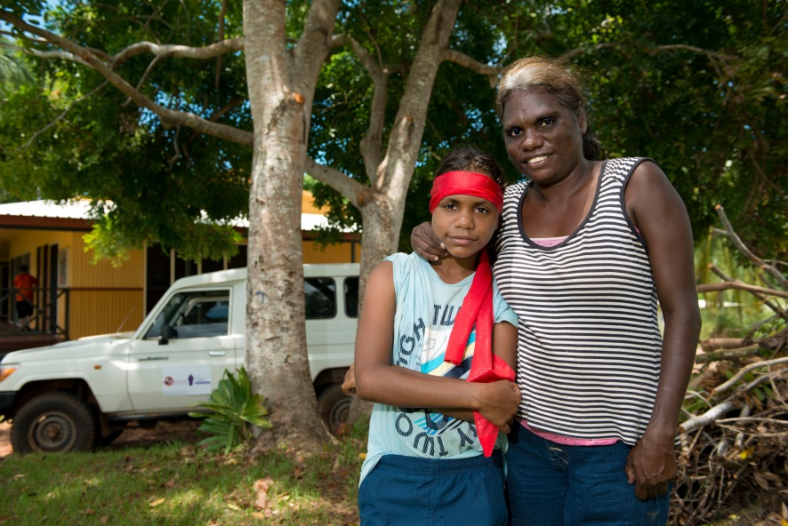
Antenatal co-morbidities & complications
Smoking
13% gestational diabetes
7% type 2 diabetes
7% gestational hypertension/ preeclampsia
6% antepartum haemorrhage
1.6% thromboembolic event(s)
11% renal disease - pylonephritis, CKD, calculi glomerulonephritis, nephrectomy,
renal agenesis

